Slide 1
String Matching Methods
Brute-Force
vs
Horspool
Joel D’Souza b00079296
Natasha Madhu g00076735
Sabbir Alam b0079438

Slide 2
OUTLINE
Introduction
Experimental Results
01
04
Complexity Analysis
Comparison
02
05
Method of Experimentation
Conclusion
03
06
Discuss the Brute Force and Horspool algorithms
Results of both the algorithms
Theoretical analysis of both algorithms
Performance comparison between both algorithms
Discuss trends witnessed through our experimentation
Methodology used to perform the experiments

Slide 3
Brute Force
Horspool
INTRODUCTION
H E L L O _ W O R L D O R O R O R O R O R O R O R O R
H E L L O _ W O R L D O R O R O R O R O R

Slide 4
COMPARISON
Horspool Algorithm
Ω(m)
𝚹(n)
O(nm)
Best Case
Average Case
Worst Case
Ω(m)
𝚹(n+m)
O(nm)
Brute Force Algorithm
n = Length of text in document, m = Length of pattern

Slide 5
METHOD OF EXPERIMENTATION
Sherlock
Methodology
War and Peace
Length of text = 6,360,210
Coded algorithms from scratch
Length of text = 195,216
Text from Project Gutenberg
Utilized the Java programming language
Text from Project Gutenberg
Written using ASCII Characters only
Used a counter to calculate number of comparisons
Written using ASCII Characters only

Slide 6
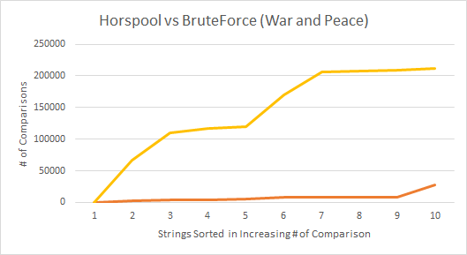
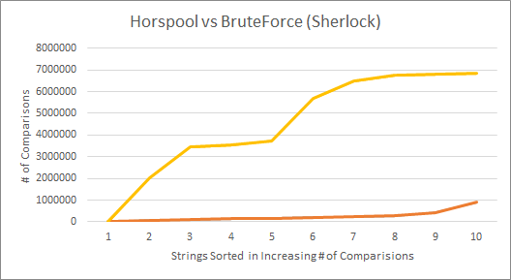
Experimental Results
---------- Horspool
---------- Brute Force

Slide 7
Sentence Number and Description | Bruteforce # of comparisons (Sherlock) | Horspool # of comparisons (Sherlock) | Bruteforce # of comparisons (War & Peace) | Horspool # of comparisons (War & Peace)
1 - Plagiarized sentence in the 1st Quarter | 2,010,863 | 86,819 | 67,071 | 2,380
2 - Plagiarized sentence in the 2nd Quarter | 3,446,902 | 145,095 | 119,810 | 4,662
3 - Plagiarized sentence in the 3rd Quarter | 5,668,688 | 239,219 | 170,023 | 7,730

Slide 8
Sentence Number and Description | Bruteforce # of comparisons (Sherlock) | Horspool # of comparisons (Sherlock) | Bruteforce # of comparisons (War & Peace) | Horspool # of comparisons (War & Peace)
4 -Plagiarized Small Sentence in the middle of the text file | 3,734,595 | 206,513 | 109,370 | 7,880
5 - Plagiarized Big Sentence in the middle of the text file | 3,539,066 | 104,853 | 116,640 | 4,208

Slide 9
Sentence Number and Description | Bruteforce # of comparisons (Sherlock) | Horspool # of comparisons (Sherlock) | Bruteforce # of comparisons (War & Peace) | Horspool # of comparisons (War & Peace)
6 - Not Plagiarized Small Sentence | 6,735,613 | 279,078 | 205,790 | 8,668
7 - Not Plagiarized Big sentence | 6,841,636 | 168,081 | 208,166 | 4,767
8 - Not plagiarized one-word sentence | 6,801,780 | 900,561 | 208,873 | 27,645

Slide 10
Sentence Number and Description | Bruteforce # of comparisons (Sherlock) | Horspool # of comparisons (Sherlock) | Bruteforce # of comparisons (War & Peace) | Horspool # of comparisons (War & Peace)
9 - Plagiarized first sentence in the text file | 64 | 64 | 60 | 60
10 - Plagiarized last sentence in the text file | 6,483,795 | 442,356 | 211,730 | 8,722
Average | 4,526,300.2 | 257,263.9 | 141,753.3 | 7,672.2

Slide 11
CONCLUSIONS
Best Case
Worst Case
Average Case
Horspool vs BruteForce
Size of the Pattern
We were able to verify the theoretical best case experimentally
We were unable to verify the worst case
It requires a specific text and string to be searched
Such patterns is not typically run through a plagiarism checker
Since we were unable to reach the worst case, naturally the average will be more biased towards the best case and we were unable to verify it
Horspool is much more efficient but requires more space
Affects Horspool more significantly as compared to Brute Force

Slide 12
Thank you!

